Slide 1
DROWSINESS DETECTION SYSTEM IN INTELLIGENT VEHICLES WITH IMAGE PROCESSING

Slide 2
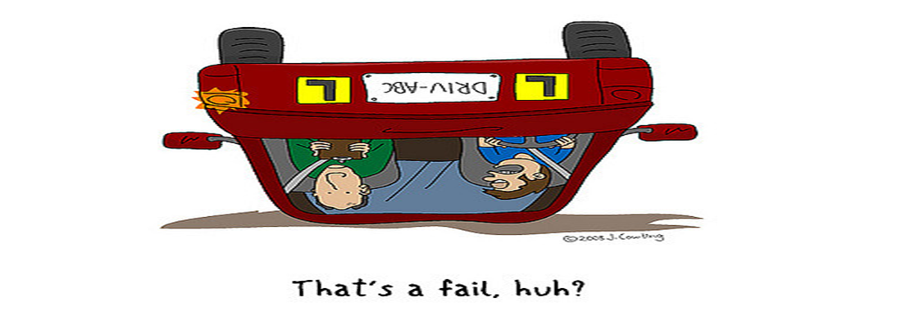

Slide 3
PROJECT MEMBERS
NAMES | MOODLE ID
Akshay Kautkar | 15204011
Arvind Kumar Maurya | 15204023
Praneta Kasbe | 15204051
Shraddha Kedar | 15204007

Slide 4
INDEX
SR NO. | CONTENT
1 | ABSTRACT
2 | INTRODUCTION
3 | LITERATURE REVIEW
4 | PROBLEM STATEMENT
5 | PROJECT SCOPE
6 | USE CASE DIAGRAM
7 | ARCHITECTURE
8 | PROJECT FUTURE PLAN
9 | SUMMARY
10 | REFERENCE

Slide 5
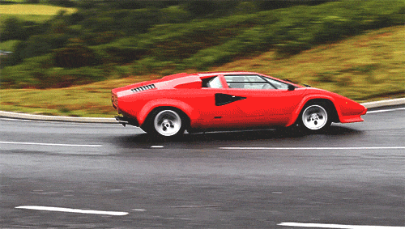
ABSTRACT
To implement a computer vision-based recognition system.
To detect human face in different light sources.
To track drivers eyes are open or closed.
To track driver’s activity and monitor visual attention with camera

Slide 6
INTRODUCTION
Driver drowsiness detection is a car safety technology which prevents accidents when the driver is getting drowsy.
Various studies have suggested that around 20% of all road accidents are fatigue-related, up to 50% on certain roads.
Recent statistics estimate that annually 1,200 deaths and 76,000 injuries can be attributed to fatigue related crashes.
Driver inattention might be the result of a lack of alertness when driving due to driver drowsiness and distraction.

Slide 7
LITERATURE REVIEW
Sr. No. | Title of the paper | Author & Year of publication | Remark/Observation
1 | Driver Drowsiness Detection using Visual Information on Android Device | Aldila Riztiane, David Habsara Hareva, Dina Stefani, Samuel Lukas - 2017 | The paper have the following techniques - Artificial neural based technique - Electroencephalograph based technique ( EEG)
2 | A Fuzzy Based Method for Driver Drowsiness Detection | Omar Rigane, Karim Abbess, Chokri Abdelmoula, Mohamed Masmoudi - 2017 | The paper has the proposed methods - Fuzzy controller - Neural Network
3 | Yawning Detection by the analysis of variational description for Monitoring Driver Drowsiness | Belhaseen AKROUT, Walid Mahdi - 2016 | The paper had described about the following method used - Extraction of the spatio-temporal Descriptor

Slide 8
COMPARISONS OF METHODS USE
METHODS | FEATURES | ADVANTAGES | DISADVANTAGES | APPLICATIONS
NEURAL NETWORK | 1. Association 2. Categorization 3Feature Extraction 4. Generalisation 5. Optimization |  | 1.Data Representation 2.Network Topology 3.Determination of Network Parameters 4.Training and Validation | 1.Image Processing and Character recognition 2.Forecasting
ELECTROENCEPHALOGRAPHN BASED TECHNIQUE (EEG) |  | 1.Ability to see brain activity as it unfolds in real time, at the level of milliseconds | 1.It's hard to figure out where in the brain the electrical activity is coming from. | 1.Human Factors 2.Social Interaction 3.Psychology and Neuroscience
FUZZY NETWORK | 1.Fuzzy Logic Design app for building fuzzy inference systems and viewing and analyzing results 2.Support for AND, OR, and NOT logic in user-defined rules | 1.less rule 2.decrease computational complexity 3.good handling the uncertainties 4.robust system | 1. decreasing accuracy | 1.Robotics 2.Washing machine

Slide 9
PROBLEM STATEMENT
Drowsy driving is a serious problem that leads to thousands of accidents each year. Motor vehicle collisions lead to significant death and disability as well as significant financial cost to both security and individual due to the driver impairments. Drowsiness is one of the factors for collisions.
Problem : A system to monitor the driver fatigue.

Slide 10
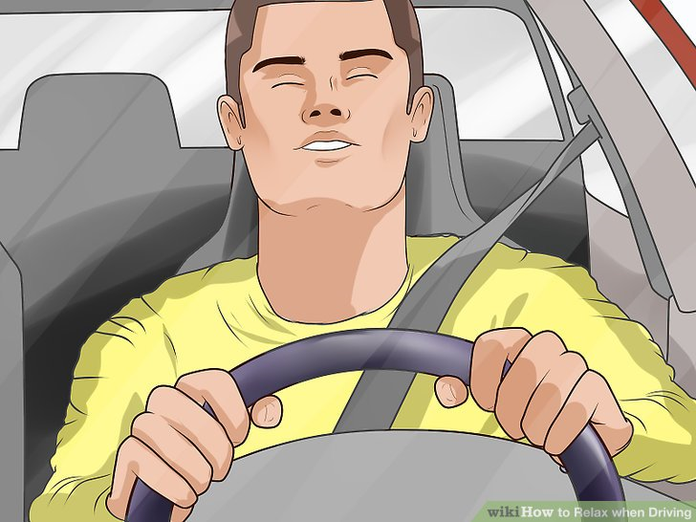
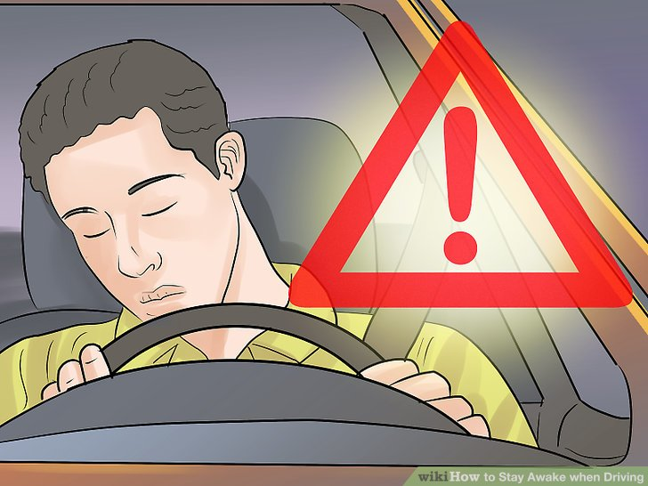
IILUSTRATIONS

Slide 11
PROJECT SCOPE
The future works may focus on the utilization of outer factors such as vehicle states, sleeping hours, weather conditions for fatigue measurement.
Driver drowsiness pose a major threat to highway safety, and the problem is particularly severe for commercial motor vehicle operators.
Twenty-four hour operations, high annual mileage, exposure to challenging environmental conditions, and demanding work schedules all contribute to this serious safety issue.
Monitoring the driver’s state of drowsiness and vigilance and providing feedback on their condition so that they can take appropriate action is one crucial step in a series of preventive measures necessary to address this problem.

Slide 12
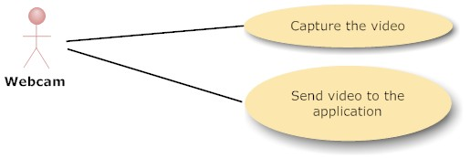
USE CASE DIAGRAM OF WEBCAMERA

Slide 13
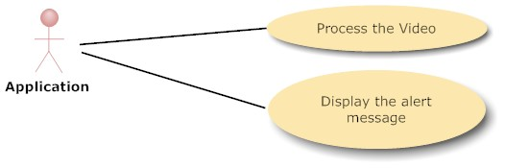
USE CASE DIAGRAM OF APPLICATION

Slide 14
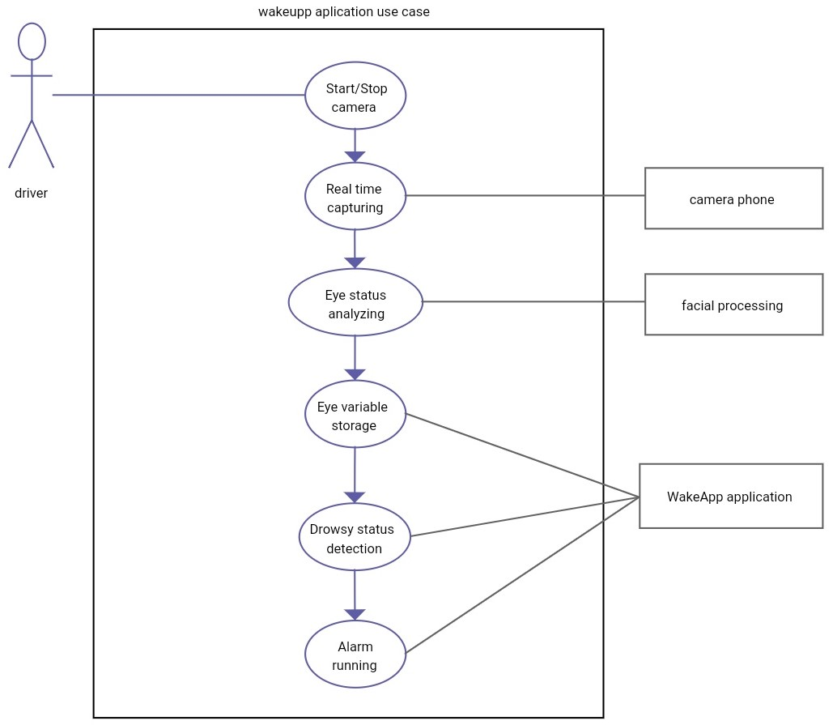
USE CASE DIAGRAM OF APPLICATION

Slide 15
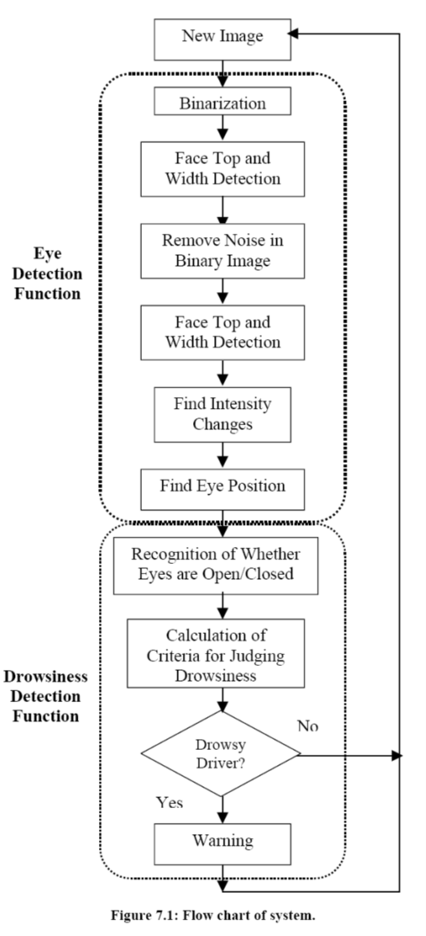
DESIGN

Slide 16
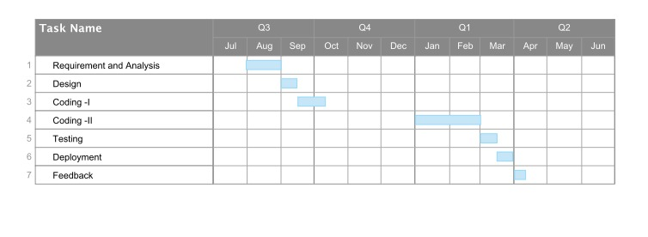
PROJECT PLANNING

Slide 17
SUMMARY
Drivers must keep a close eye on the road, so they can react to sudden events immediately.
Driver fatigue often becomes a direct cause of many traffic accidents.
Therefore, there is a need to develop the systems that will detect and notify a driver of her/him bad condition, which could significantly reduce the number of fatigue-related car accidents.
One of the technical possibilities to implement driver drowsiness detection systems is to use the vision-based approach.
This article presents the use of driver drowsiness detection systems.

Slide 18
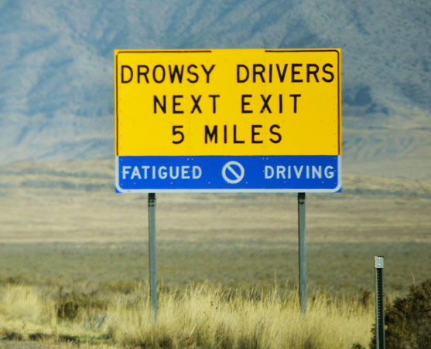

Slide 19
REFERENCES
1. Biometrics: Personal Identification in a Networked Society. A. Jain, R. Bolle and S. Pankanti, eds. Kluwer, 1999.
2. J. Daugman, Biometric Personal Identification System Based on Iris Analysis, United States Patent, no.5291560, 1994..
3. John Daugman, Neural Image Processing StrategiesApplied in Real-Time Pattern Recognition, Real-TimeImaging, 1997, 3(3): pp 157-171..
4. Weirwille, W.W. (1994). "Overview of Research on Driver Drowsiness Definition and Driver Drowsiness Detection," 14 International Technical Conference on Enhanced Safety of Vehicles, pp 23-26..
5. J. Daugman. The importance of being random: Statistical principles of iris recognition. Pattern Recognition, vol. 36, no. 2, pp.279-291.

Slide 20
THANK YOU !!!

